Slide 1


Yandex School of Data Analysis
Natural Language Processing
Language Modeling
Ignat Romanov
(based on materials from Lena Voita)
Lecture-blog and lots of additional materials are here:
https://lena-voita.github.io/nlp_course/language_modeling.html
NLP Course For You

Slide 2

What is going to happen:
What is Language Modeling?
General Framework
N-Gram Language Models
Neural Language Models (NN-LM)
Generation Strategies
Evaluation
Practical Tips
Analysis and Interpretability

Slide 3
What is going to happen:
What is Language Modeling?
General Framework
N-Gram Language Models
Neural Language Models (NN-LM)
Generation Strategies
Evaluation
Practical Tips
Analysis and Interpretability

Slide 4
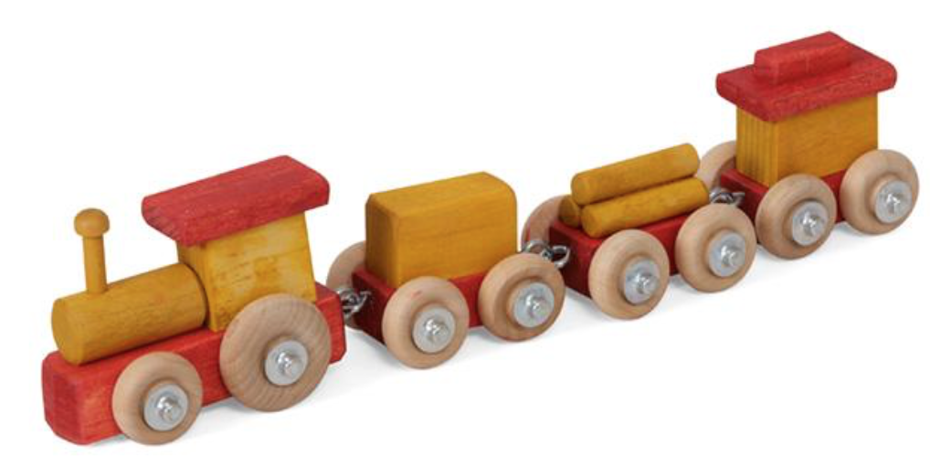
What is a model?

Slide 5
What is a model?
have some properties of trains (look like ones)
can behave similarly to trains

Slide 6
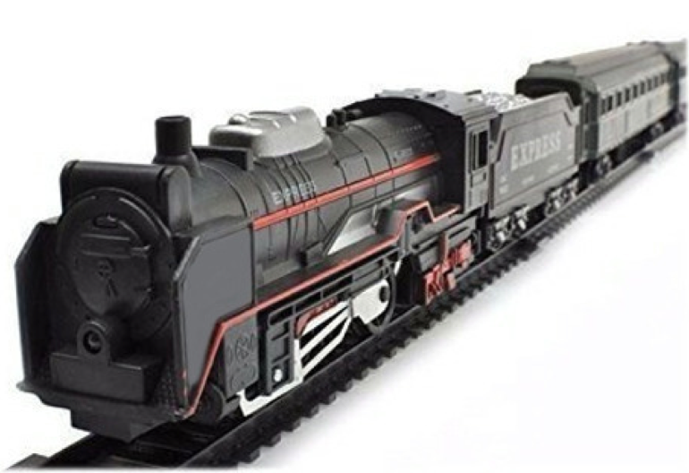
What is a model?
have some properties of trains (look like ones)
can behave similarly to trains
good models have more of the above

Slide 7
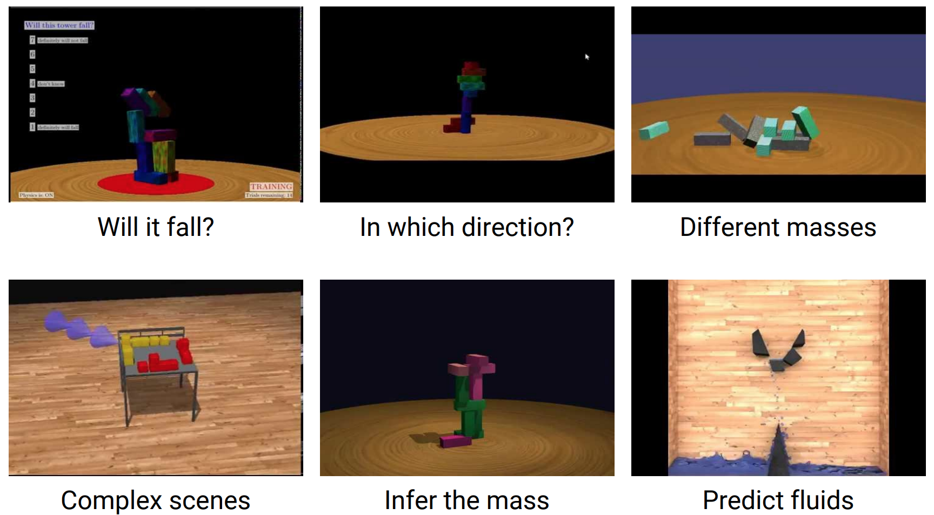
Why do we need them?
The picture is from the presentation by Peter Battaglia: http://phys.csail.mit.edu/talks/battaglia.pdf

Slide 8
Why do we need them?
Identifying the most influential patterns in the surrounding world
Experiment simplification
The picture is from the presentation by Peter Battaglia: http://phys.csail.mit.edu/talks/battaglia.pdf

Slide 9

Model of a Language?..

Slide 10
Model of a Language?..
The intuition is exactly the same!
What is different, is the notion of an event: for language, an event is a linguistic unit (text, sentence, token, symbol).

Slide 11
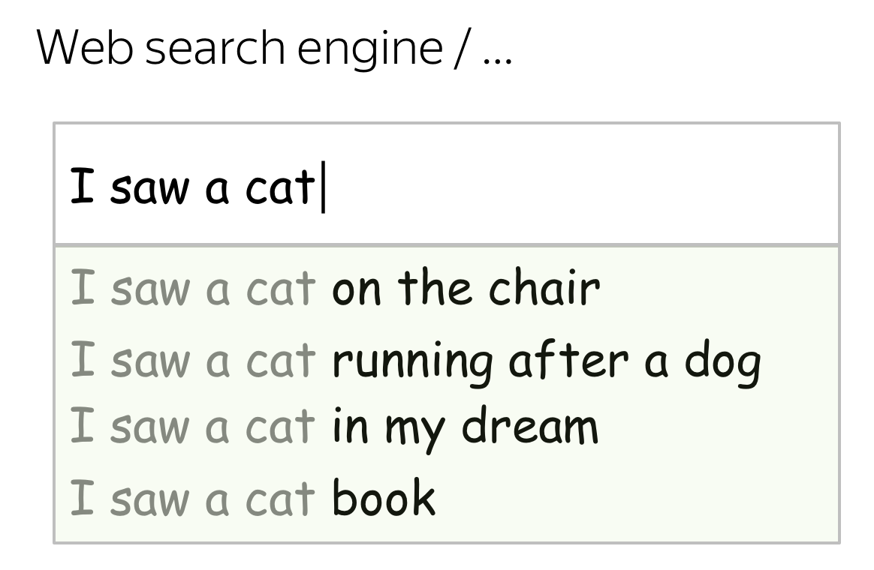
How can this be useful?
We deal with Language Models every day!

Slide 12
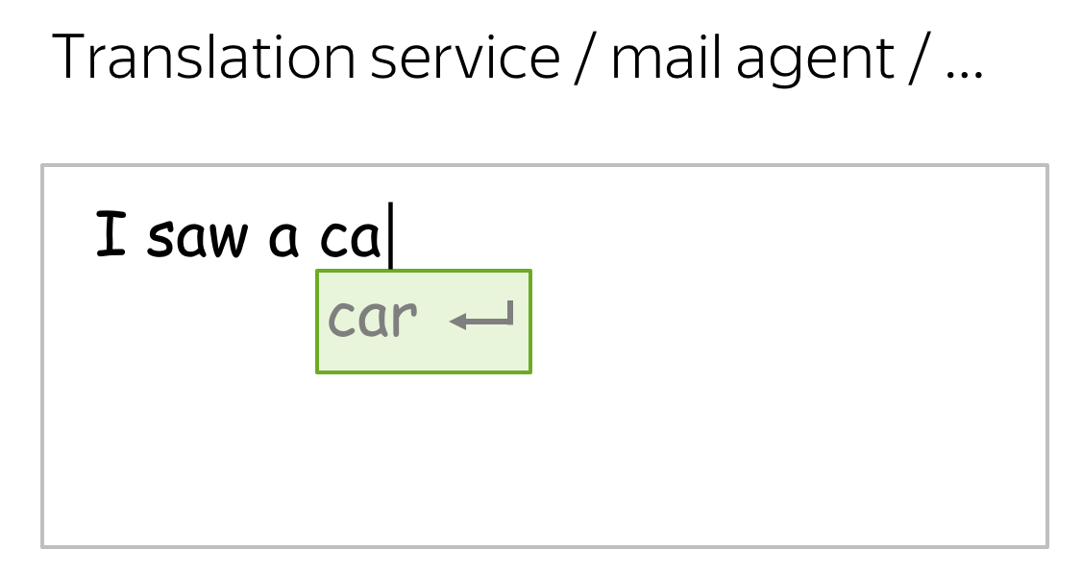
How can this be useful?
We deal with Language Models every day!

Slide 13
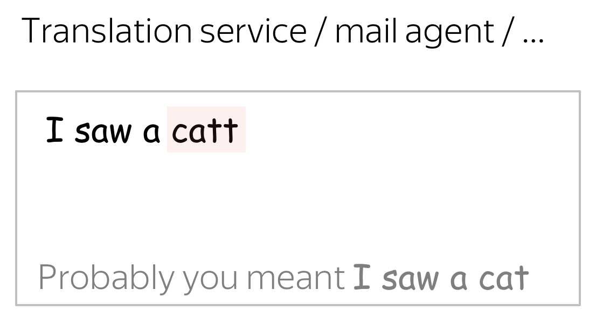
How can this be useful?
We deal with Language Models every day!

Slide 14
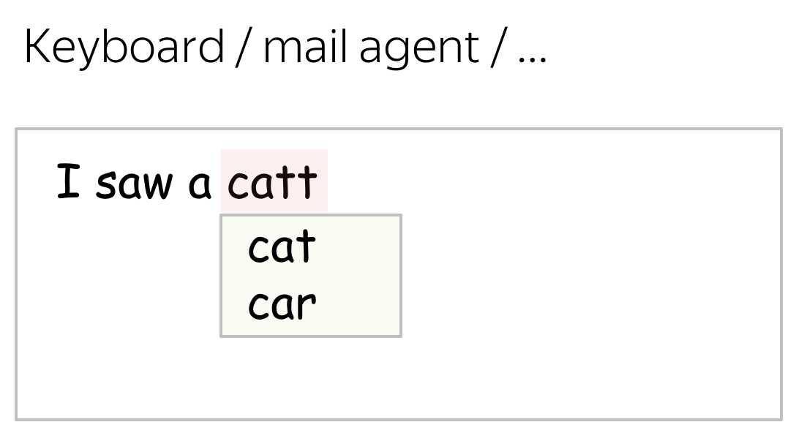
How can this be useful?
We deal with Language Models every day!

Slide 15
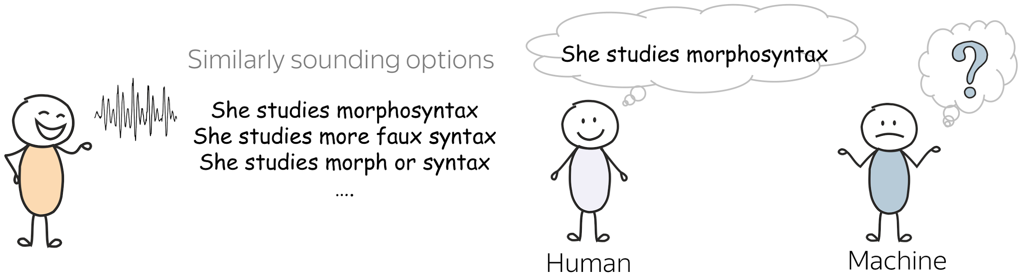
What is easy for humans can be very hard for machines
The morphosyntax example is from the slides by Alex Lascarides and Sharon Goldwater, Foundations of Natural Language Processing course at the University of Edinburgh.

Slide 16
What is going to happen:
What is Language Modeling?
General Framework
N-Gram Language Models
Neural Language Models (NN-LM)
Generation Strategies
Evaluation
Practical Tips
Analysis and Interpretability

Slide 17
What is going to happen:
What is Language Modeling?
General Framework
N-Gram Language Models
Neural Language Models (NN-LM)
Generation Strategies
Evaluation
Practical Tips
Analysis and Interpretability

Slide 18
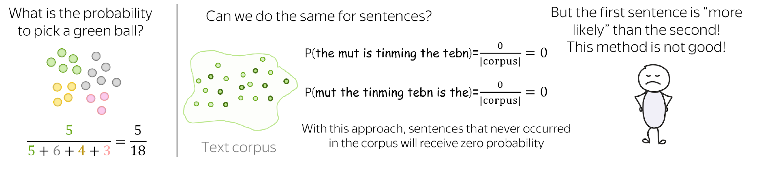
How likely is a sentence to appear in a language?

Slide 19
How likely is a sentence to appear in a language?

Slide 20
How likely is a sentence to appear in a language?

Slide 21
How likely is a sentence to appear in a language?

Slide 22
How likely is a sentence to appear in a language?
We can not estimate sentence probabilities reliably if we treat them as atomic units!

Slide 23
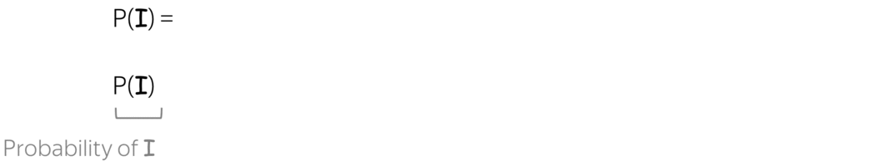

Sentence Probability: Decompose into Smaller Parts
Imagine we
read the sentence I saw a cat on a mat word by word,
update probability every time we see a new token

Slide 24
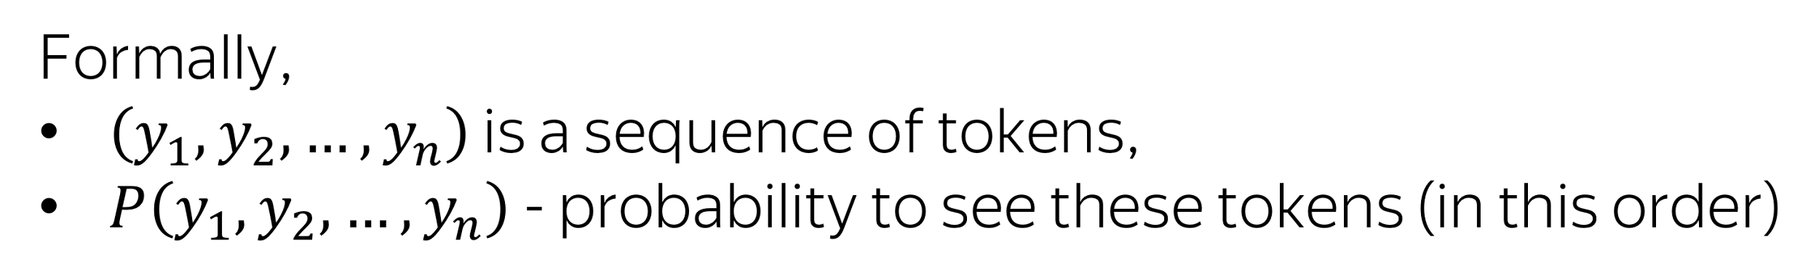
Sentence Probability: Decompose into Smaller Parts
Using the product rule of probability (aka “chain rule”), we get:

Slide 25
We got: Left-to-Right Language Modeling Framework
This is the standard framework
Models differ in a way they evaluate probabilities
Later in the course, we’ll see other language models (e.g., masked language models)

Slide 26
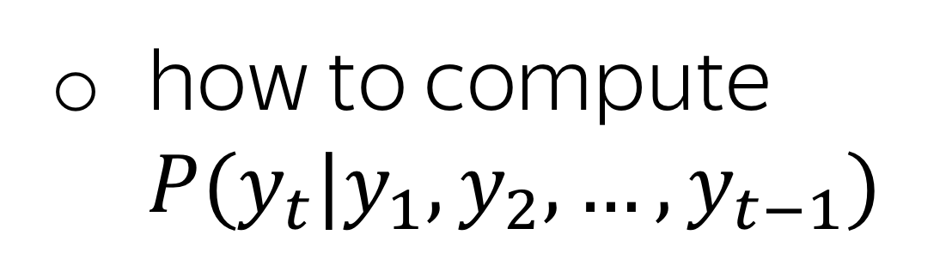
We got: Left-to-Right Language Modeling Framework
This is the standard framework
Models differ in a way they evaluate probabilities
Later in the course, we’ll see other language models (e.g., masked language models)
Need to define:
N-gram models
Neural models

Slide 27
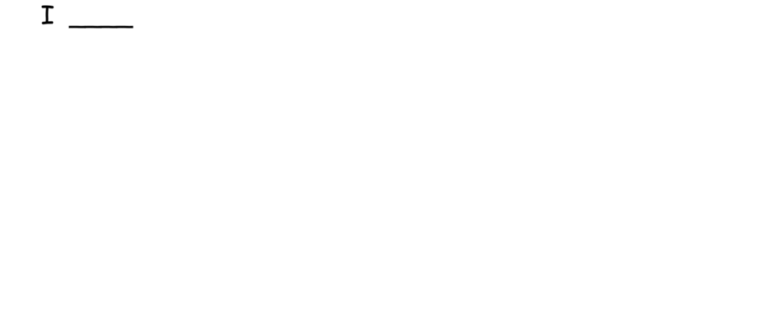
Generate a Text Using a Language Model

Slide 28
Generate a Text Using a Language Model
Alternatively, you can use greedy decoding: pick the token with the highest probability. We’ll see some examples a bit later.

Slide 29
What is going to happen:
What is Language Modeling?
General Framework
N-Gram Language Models
Neural Language Models (NN-LM)
Generation Strategies
Evaluation
Practical Tips
Analysis and Interpretability

Slide 30
What is going to happen:
What is Language Modeling?
General Framework
N-Gram Language Models
Neural Language Models (NN-LM)
Generation Strategies
Evaluation
Practical Tips
Analysis and Interpretability

Slide 31
Recap: What We Need

Slide 32
Recap: What We Need
This is a classical approach, so the solution is clear:
I.e., we do it almost as we counted green balls in the basket.

Slide 33
Recap: What We Need
This is a classical approach, so the solution is clear:
I.e., we do it almost as we counted green balls in the basket.
This “almost” contains the key components of N-gram models: Markov property and smoothings

Slide 34
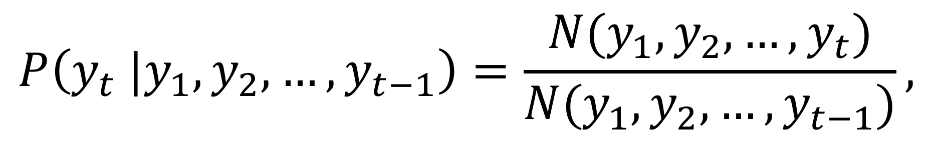
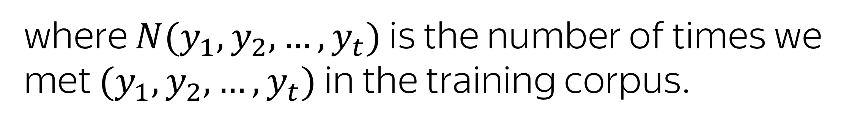
How to evaluate conditional probabilities?
A straightforward way:

Slide 35
How to evaluate conditional probabilities?
A straightforward way:
These are often long sequences, and many of the counts will be zero!

Slide 36
Markov Assumption
For an n-gram model,
all previous tokens
n-1 previous token

Slide 37
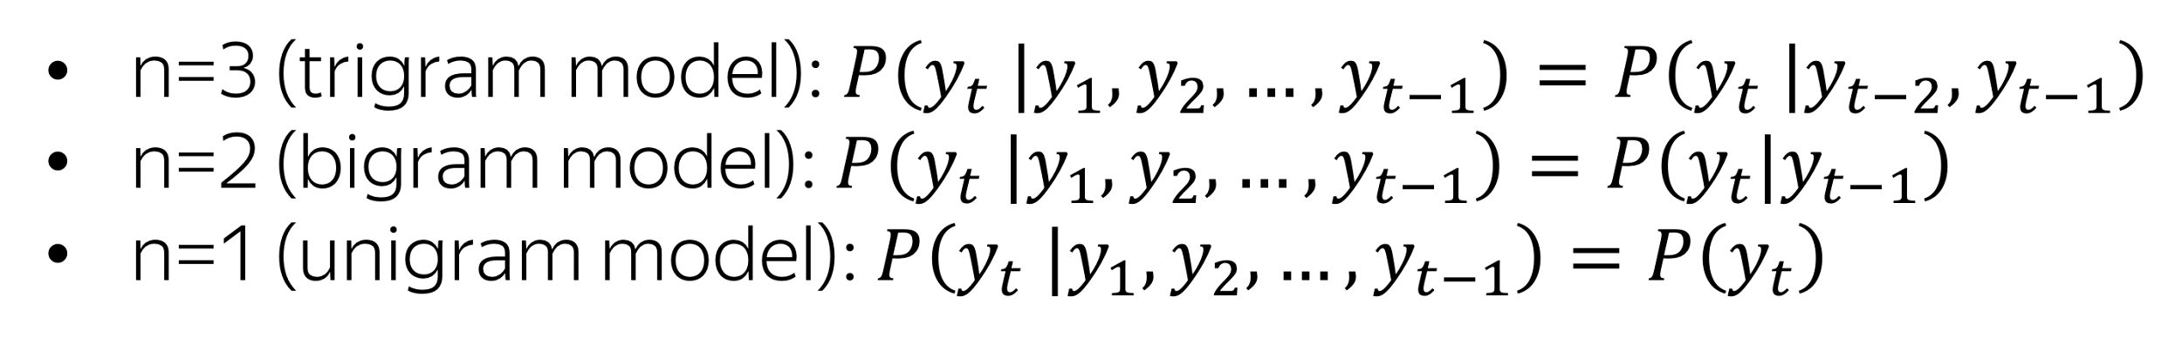
Markov Assumption
For an n-gram model,
all previous tokens
n-1 previous token
For example,

Slide 38
Markov Assumption: Example
P(I saw a cat on a mat) = ?
Before
P(I saw a cat on a mat) =
P(I)
P(saw | I)
P(a | I saw)
.
.
.
P(cat | I saw a)
.
P(on | I saw a cat)
.
P(a | I saw a cat on)
.
P(mat | I saw a cat on a)

Slide 39
Markov Assumption: Example
P(I saw a cat on a mat) = ?
Before
After (3-gram)
P(I saw a cat on a mat) =
P(I saw a cat on a mat) =
P(I)
P(saw | I)
P(a | I saw)
P(I)
P(saw | I)
P(a | I saw)
P(I)
P(saw | I)
P(a | I saw)
.
.
.
.
.
.
.
.
.
P(cat | I saw a)
P(cat | I saw a)
P(cat | saw a)
.
.
.
P(on | I saw a cat)
P(on | I saw a cat)
P(on | a cat)
.
.
.
P(a | I saw a cat on)
P(a | I saw a cat on)
P(a | cat on)
.
.
.
P(mat | I saw a cat on a)
P(mat | I saw a cat on a)
P(mat | on a)
ignore
use

Slide 40
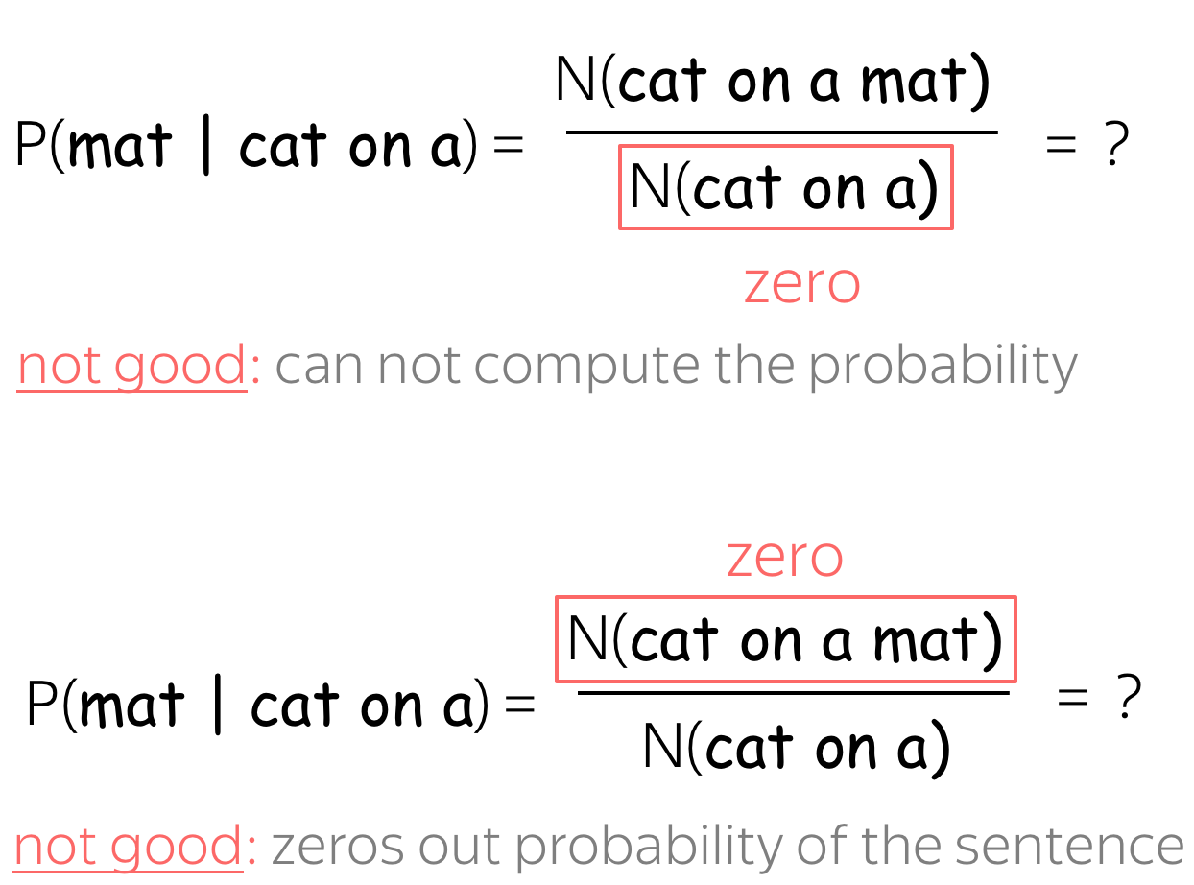
Houston, we have a problem
N(cat on a mat)
P(mat | I saw a cat on a) = P(mat | cat on a) =
N(cat on a)

Slide 41
Backoff (aka Stupid Backoff)
Use less context for contexts we don’t know much about:
if you can, use trigram,
if not, bigram,
if not, unigram

Slide 42
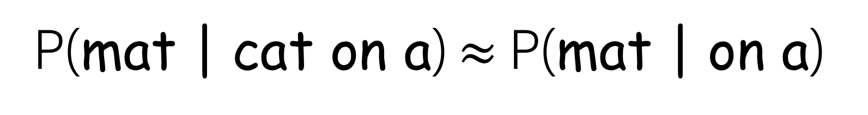
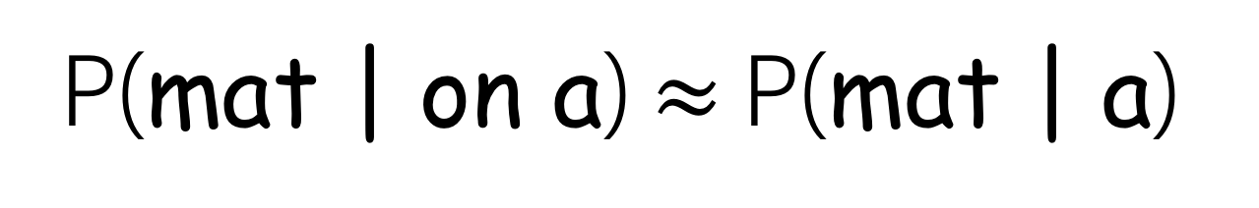
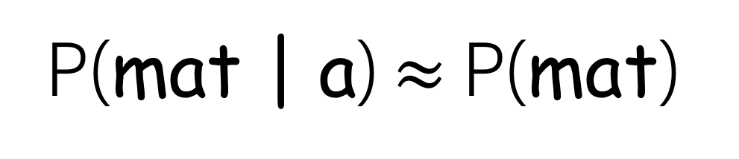
Backoff (aka Stupid Backoff)
N(cat on a) = 0
try ”on a”
N(on a) = 0
try ”a”
Use less context for contexts we don’t know much about:
if you can, use trigram,
if not, bigram,
if not, unigram
N(a) = 0
try unigram

Slide 43
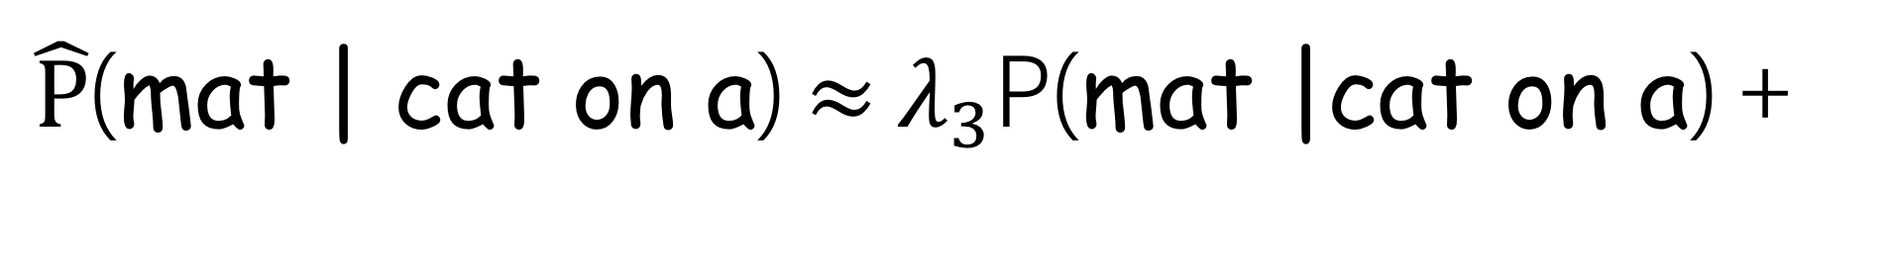
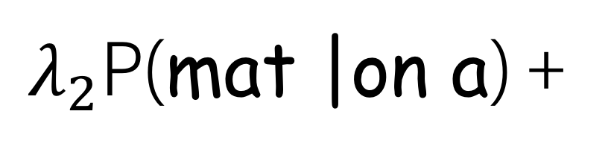
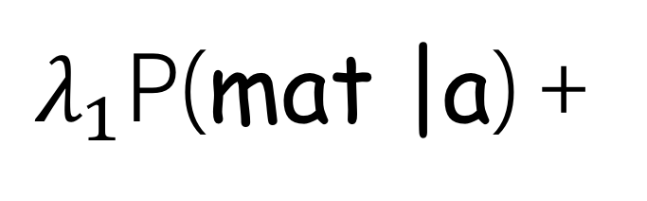
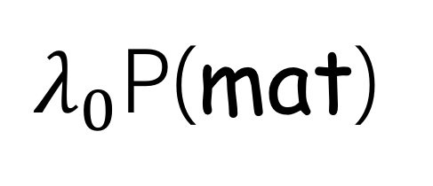
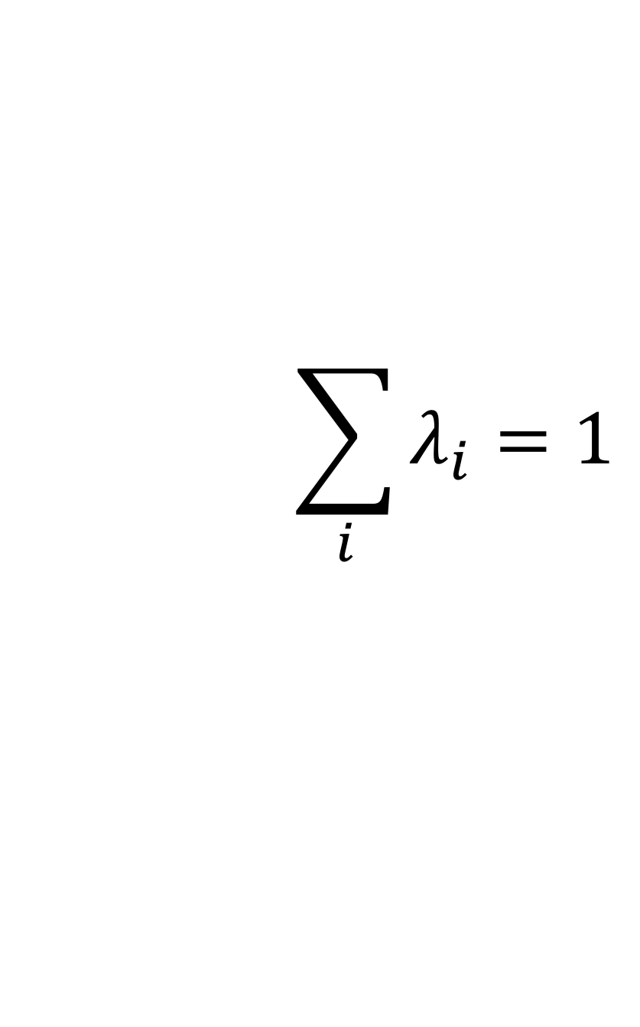
More Clever: Linear Interpolation

Slide 44
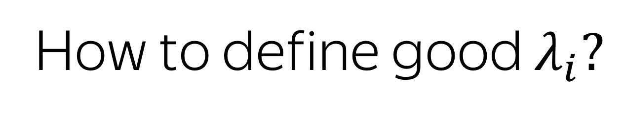
More Clever: Linear Interpolation

Slide 45
More Clever: Linear Interpolation
Cross-validation!

Slide 46
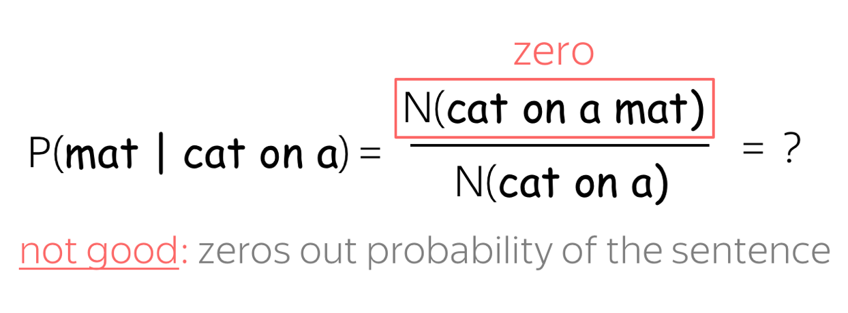
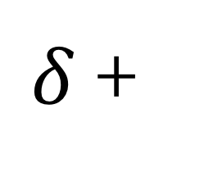
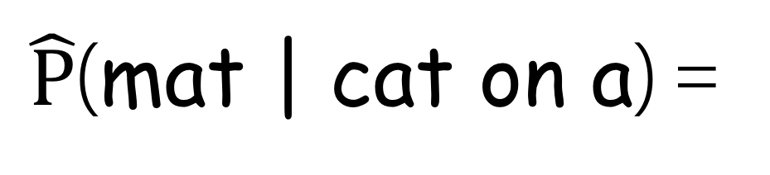
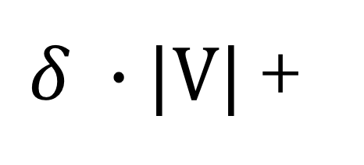
Laplace (add-one) smoothing
N(cat on a mat)
N(cat on a)

Slide 47
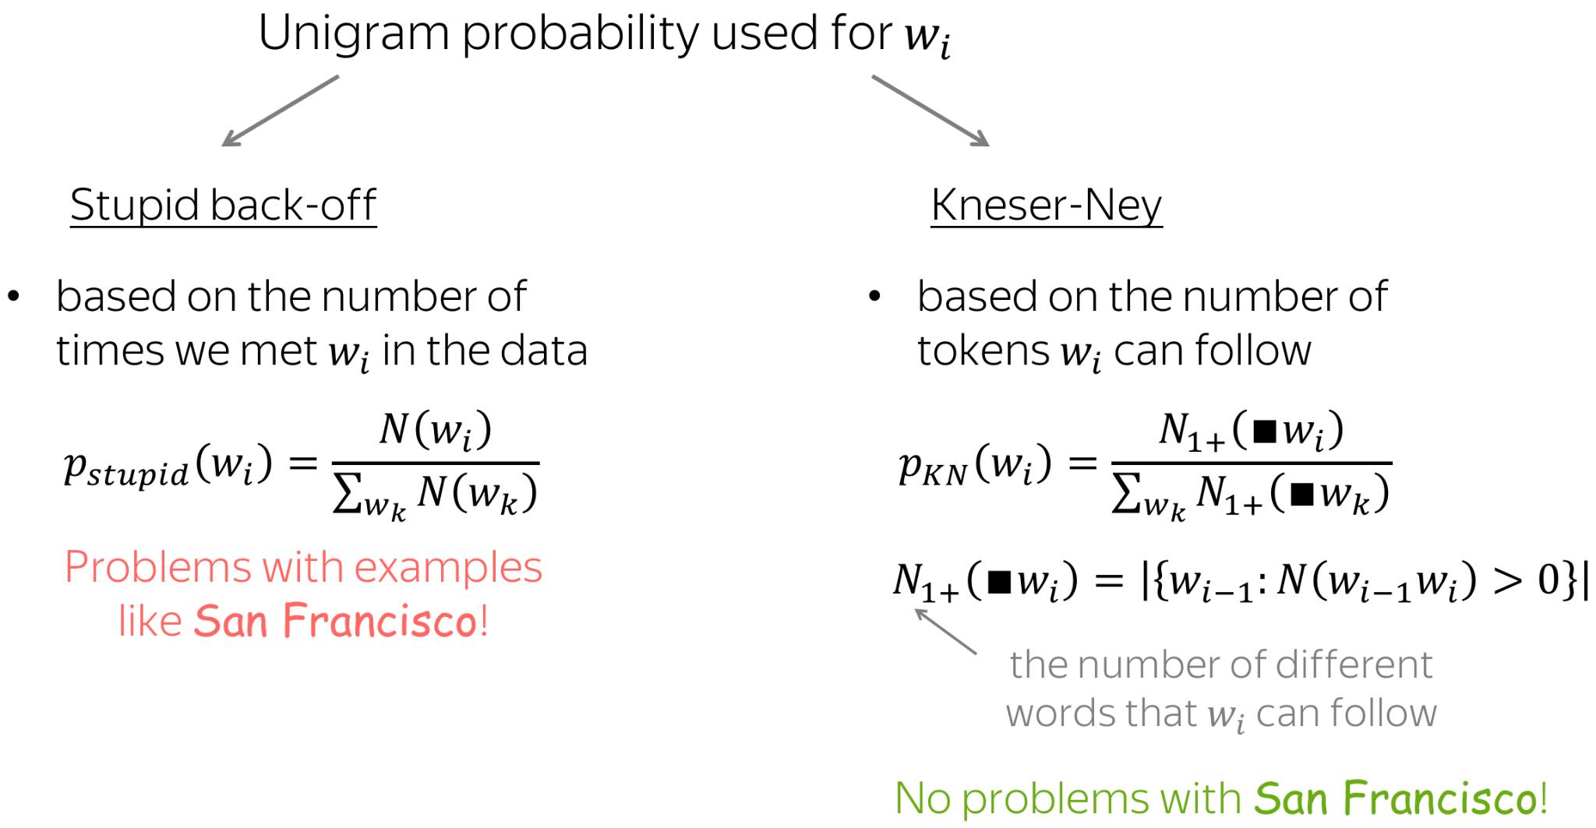
More clever smoothings

Slide 48
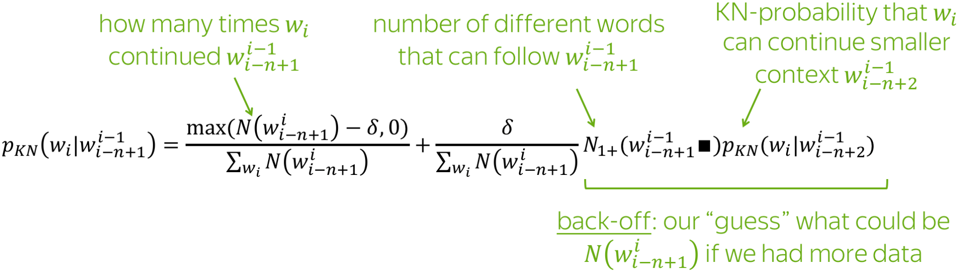
More clever smoothings

Slide 49
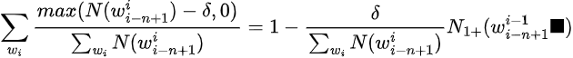
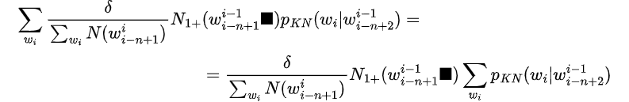
Sanity Check

Slide 50
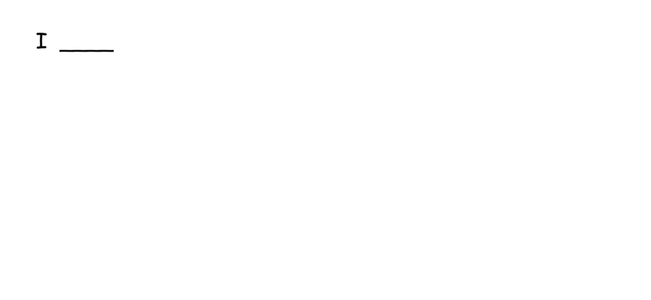
Generate a Text Using an N-gram Language Model
Let’s take e.g. a 3-gram model:

Slide 51
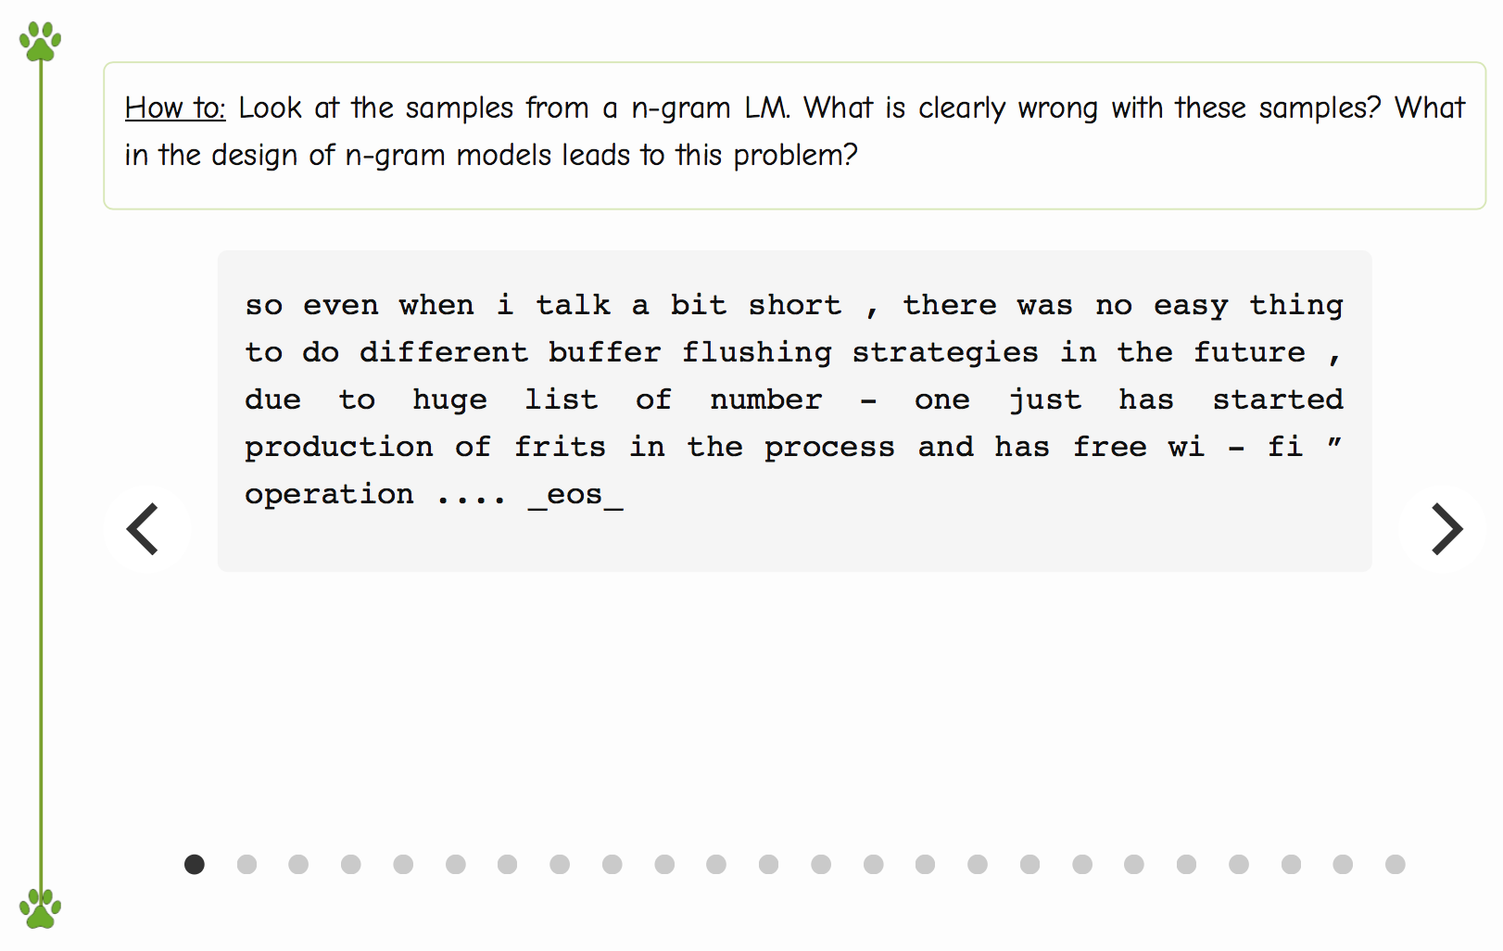
Examples of Generated Texts

Slide 52
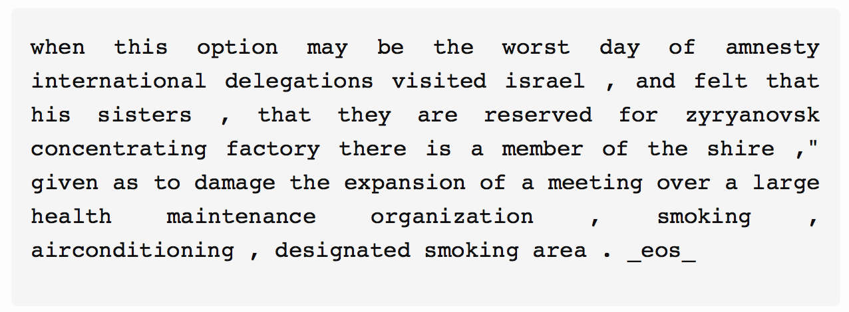


Examples of Generated Texts

Slide 53
Examples of Generated Texts

Slide 54
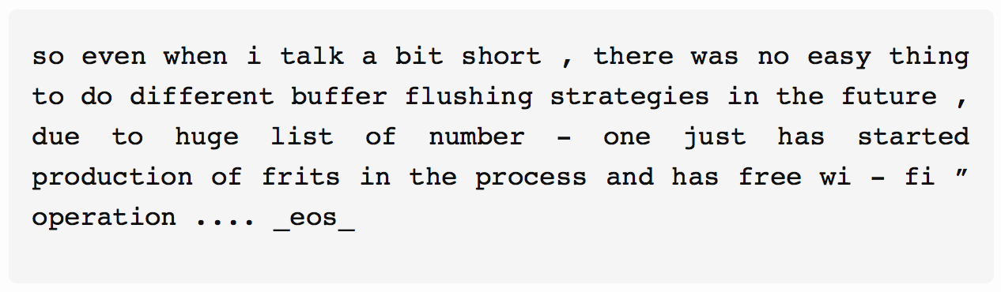
Examples of Generated Texts
What is wrong with these texts? Why?

Slide 55

Examples of Generated Texts
Texts are incoherent because fixed contexts are bad!

Slide 56
What is going to happen:
What is Language Modeling?
General Framework
N-Gram Language Models
Neural Language Models (NN-LM)
Generation Strategies
Evaluation
Practical Tips
Analysis and Interpretability

Slide 57
What is going to happen:
What is Language Modeling?
General Framework
N-Gram Language Models
Neural Language Models (NN-LM)
Generation Strategies
Evaluation
Practical Tips
Analysis and Interpretability
Idea and High-Level Pipeline
Training: Cross-Entropy
Models: Recurrent
Models: Convolutional

Slide 58
Recap: What We Need
Classical approaches:

Slide 59
Recap: What We Need
In neural networks, we do as usually:

Slide 60
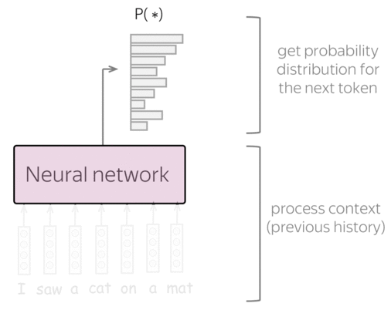

General View
process context – model-specific
Get vector representation of the previous context
evaluate probabilities – model-agnostic
Predict probability distribution for the next token
Classify into |V| classes

Slide 61
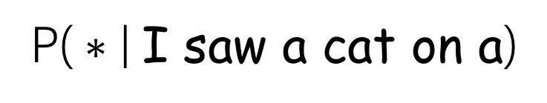
High-Level Pipeline
|V| tokens
d-sized vector
Linear
layer
softmax
get probability distribution for the next token
h: vector representation of context I saw a cat on a
Neural network
process context
(previous history)
Input word embeddings
I
saw
a
cat
on
a

Slide 62
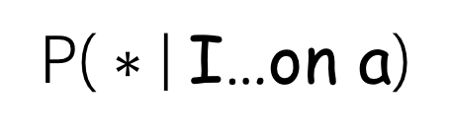
High-Level Pipeline
|V| tokens
d-sized vector
Linear
layer
softmax
h: vector representation of context I saw a cat on a
Simple way of thinking about this:
We have:
h - vector of size d
Neural network
Transform linearly from size d to size |V|
We need:
vector of size |V| – probabilities for for all tokens in the vocabulary
d features (vector dimensionality)
T
I
saw
a
cat
on
a
Linear
layer
softmax
x
h^{T}

Slide 63
High-Level Pipeline
|V| tokens
d-sized vector
Linear
layer
softmax
h: vector representation of context I saw a cat on a
Output Embeddings View
Neural network
|V| vectors
T
T
x
Linear
layer
:
x
…
vector dim. d
h^{T}
h^{T}
I
saw
a
cat
on
a
h - vector representation of the context
vector representations of classes, i.e. tokens: output word embeddings

Slide 64
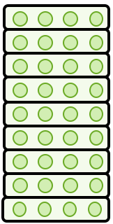
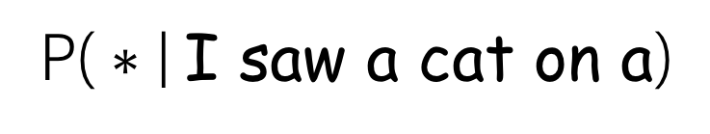
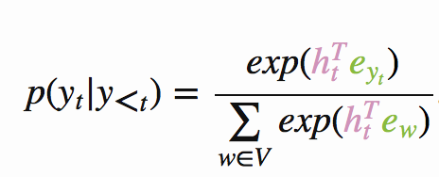
High-Level Pipeline: Output Embeddings View
Output word embeddings
get probability distribution for the next token
Take dot-product of h with output word embeddings
softmax
Neural network
h: vector representation of context I saw a cat on a
process context
(previous history)
Input word embeddings
I
saw
a
cat
on
a

Slide 65
What is going to happen:
What is Language Modeling?
General Framework
N-Gram Language Models
Neural Language Models (NN-LM)
Generation Strategies
Evaluation
Practical Tips
Analysis and Interpretability
Idea and High-Level Pipeline
Training: Cross-Entropy
Models: Recurrent
Models: Convolutional

Slide 66
What is going to happen:
What is Language Modeling?
General Framework
N-Gram Language Models
Neural Language Models (NN-LM)
Generation Strategies
Evaluation
Practical Tips
Analysis and Interpretability
Idea and High-Level Pipeline
Training: Cross-Entropy
Models: Recurrent
Models: Convolutional

Slide 67
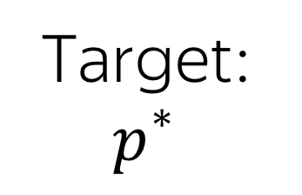
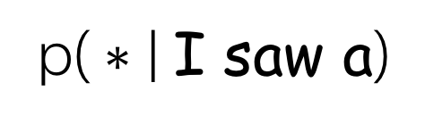
Training: Cross-Entropy
Target at this step
Training example: I saw a cat on a mat <eos>
Model prediction:
0
0
0
0
0
0
0
0
cat
1

Slide 68
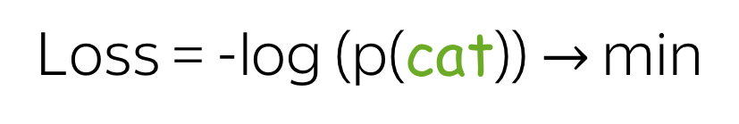
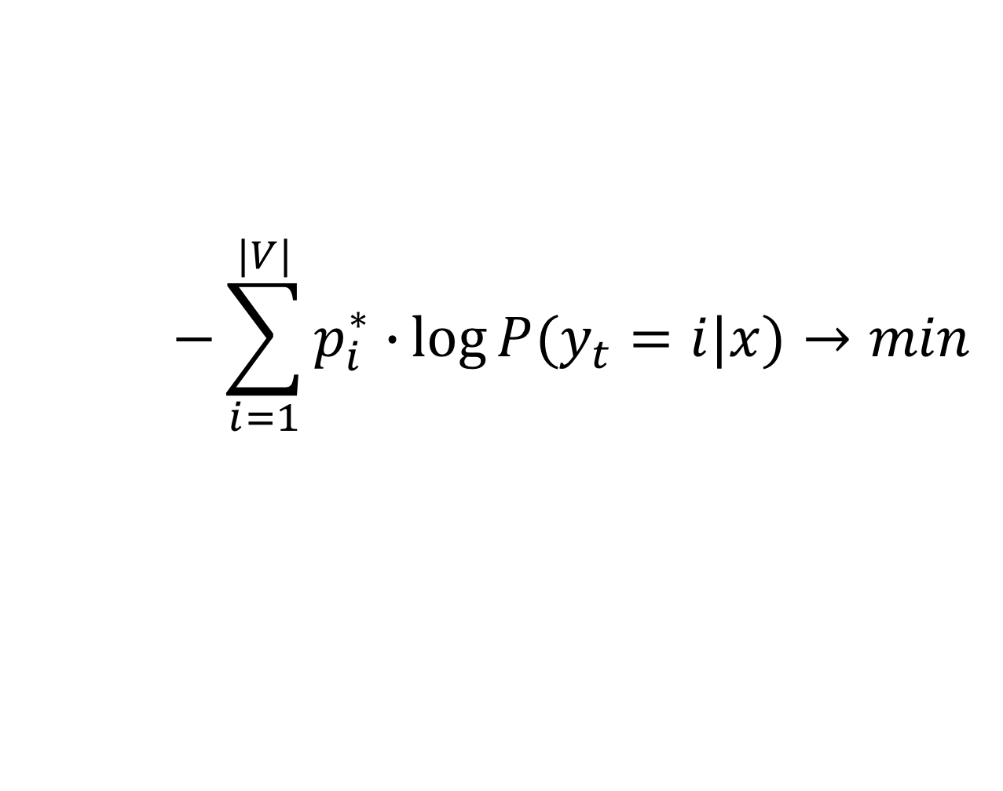
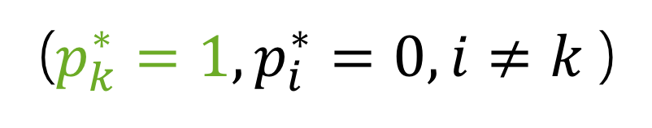
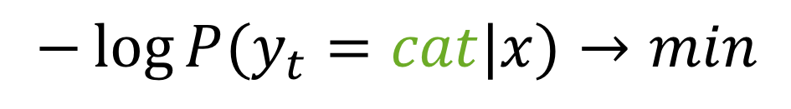
Training: Cross-Entropy
Target at this step
Training example: I saw a cat on a mat <eos>
Model prediction:
0
0
0
0
0
0
0
0
decrease
cat
1
increase
decrease
Cross-entropy loss:
For one-hot targets, this is equivalent to

Slide 69

Training: Cross-Entropy
Target at this step
Training example: I saw a cat on a mat <eos>
Model prediction:
0
0
0
0
0
0
0
0
decrease
cat
1
increase
decrease
Cross-entropy loss:
For one-hot targets, this is equivalent to

Slide 70
What is going to happen:
What is Language Modeling?
General Framework
N-Gram Language Models
Neural Language Models (NN-LM)
Generation Strategies
Evaluation
Practical Tips
Analysis and Interpretability
Idea and High-Level Pipeline
Training: Cross-Entropy
Models: Recurrent
Models: Convolutional

Slide 71
What is going to happen:
What is Language Modeling?
General Framework
N-Gram Language Models
Neural Language Models (NN-LM)
Generation Strategies
Evaluation
Practical Tips
Analysis and Interpretability
Idea and High-Level Pipeline
Training: Cross-Entropy
Models: Recurrent
Models: Convolutional

Slide 72

Recurrent Models for Language Modeling
simple: read a text, predict next token at each step

Slide 73

Recurrent Models for Language Modeling
Multi-layer: feed the states from one RNN to the next

Slide 74
What is going to happen:
What is Language Modeling?
General Framework
N-Gram Language Models
Neural Language Models (NN-LM)
Generation Strategies
Evaluation
Practical Tips
Analysis and Interpretability
Idea and High-Level Pipeline
Training: Cross-Entropy
Models: Recurrent
Models: Convolutional

Slide 75
What is going to happen:
What is Language Modeling?
General Framework
N-Gram Language Models
Neural Language Models (NN-LM)
Generation Strategies
Evaluation
Practical Tips
Analysis and Interpretability
Idea and High-Level Pipeline
Training: Cross-Entropy
Models: Recurrent
Models: Convolutional
NLP Course For You: if you want, read here

Slide 76
What is going to happen:
What is Language Modeling?
General Framework
N-Gram Language Models
Neural Language Models (NN-LM)
Generation Strategies
Evaluation
Practical Tips
Analysis and Interpretability

Slide 77
What is going to happen:
What is Language Modeling?
General Framework
N-Gram Language Models
Neural Language Models (NN-LM)
Generation Strategies
Evaluation
Practical Tips
Analysis and Interpretability
Goal: Coherence and Diversity
Sampling
Sampling with Temperature
Top-K Sampling
Top-p (Nucleus) Sampling

Slide 78
We Need: Coherence and Diversity
Usually, we need generated texts to be:
coherent - the generated text has to make sense;
diverse - the model has to be able to produce very different samples.

Slide 79
We Need: Coherence and Diversity
Usually, we need generated texts to be:
coherent - the generated text has to make sense;
diverse - the model has to be able to produce very different samples.
How can we control this?

Slide 80

Sampling with Temperature

Slide 81

Sampling with Temperature

Slide 82

Sampling with Temperature
http://lena-voita.github.io/nlp_course/language_modeling.html#generation_strategies_temperature

Slide 83



Examples: Temperature=2
http://lena-voita.github.io/nlp_course/language_modeling.html#generation_strategies_temperature

Slide 84
Examples: Temperature=2
http://lena-voita.github.io/nlp_course/language_modeling.html#generation_strategies_temperature

Slide 85
Examples: Temperature=2
http://lena-voita.github.io/nlp_course/language_modeling.html#generation_strategies_temperature

Slide 86

Examples: Temperature=0.2
http://lena-voita.github.io/nlp_course/language_modeling.html#generation_strategies_temperature

Slide 87

Examples: Temperature=0.2
(this sample appeared several times)
http://lena-voita.github.io/nlp_course/language_modeling.html#generation_strategies_temperature

Slide 88

Examples: Temperature=0.2
(this sample appeared many times)
http://lena-voita.github.io/nlp_course/language_modeling.html#generation_strategies_temperature

Slide 89
Sampling with Temperature
Temperature can help a bit
It’s not ideal: both increasing and decreasing improve one of coherence and diversity, but hurt the other
-
diversity
+
coherence
+
-
0
1
temperature
(standard sampling)

Slide 90

Top-K Sampling: top K tokens
always sample from top-K most probable tokens (usually, K is about 10-50)

Slide 91

Problems of the Top-K Sampling: Fixed K is Not Good

Slide 92


Top-p (Nucleus) Sampling: p% of the probability mass
at each step, pick so many top tokens to cover p% of the probability mass

Slide 93
What is going to happen:
What is Language Modeling?
General Framework
N-Gram Language Models
Neural Language Models (NN-LM)
Generation Strategies
Evaluation
Practical Tips
Analysis and Interpretability

Slide 94
What is going to happen:
What is Language Modeling?
General Framework
N-Gram Language Models
Neural Language Models (NN-LM)
Generation Strategies
Evaluation
Practical Tips
Analysis and Interpretability

Slide 95

Evaluation Intuition

Slide 96

Evaluation Intuition

Slide 97


Perplexity and Text Log- Likelihood
Log-likelihood of the text
Note: cross-entropy (our loss) is negative log-likelihood

Slide 98

Perplexity and Text Log- Likelihood
Log-likelihood of the text
Note: cross-entropy (our loss) is negative log-likelihood
It is more common to report its transformation called perplexity:
Low perplexity -> high data likelihood -> good!

Slide 99
Perplexity: Which Values Does it Take?
The best perplexity is 1
If the model is perfect and assigns probability 1 to correct tokens, then the log-probabilities are zero

Slide 100
Perplexity: Which Values Does it Take?
The best perplexity is 1
If the model is perfect and assigns probability 1 to correct tokens, then the log-probabilities are zero
The worst perplexity is |V|
If the model knows nothing about the data, it assigns probability 1/|V| to all tokens, regardless of context. Then:

Slide 101
Perplexity: Which Values Does it Take?
The best perplexity is 1
Perplexity is always between 1 and |V|
If the model is perfect and assigns probability 1 to correct tokens, then the log-probabilities are zero
The worst perplexity is |V|
If the model knows nothing about the data, it assigns probability 1/|V| to all tokens, regardless of context. Then:

Slide 102
What is going to happen:
What is Language Modeling?
General Framework
N-Gram Language Models
Neural Language Models (NN-LM)
Generation Strategies
Evaluation
Practical Tips
Analysis and Interpretability

Slide 103
What is going to happen:
What is Language Modeling?
General Framework
N-Gram Language Models
Neural Language Models (NN-LM)
Generation Strategies
Evaluation
Practical Tips
Analysis and Interpretability
Weight Tying

Slide 104

Weight Tying (aka Parameter Sharing)
Default (no weight tying)

Slide 105

Weight Tying (aka Parameter Sharing)
Large part of model parameters comes from these matrices - you can reduce model size!
Default (no weight tying)
Weight tying

Slide 106
What is going to happen:
What is Language Modeling?
General Framework
N-Gram Language Models
Neural Language Models (NN-LM)
Generation Strategies
Evaluation
Practical Tips
Analysis and Interpretability

Slide 107
What is going to happen:
What is Language Modeling?
General Framework
N-Gram Language Models
Neural Language Models (NN-LM)
Generation Strategies
Evaluation
Practical Tips
Analysis and Interpretability

Slide 108

Examples of generated texts
Char-level LSTM trained on Latex book on algebraic geometry
The examples are from the paper Visualizing and Understanding Recurrent Networks

Slide 109

Examples of generated texts
Char-level LSTM trained on Linux source code
The examples are from the paper Visualizing and Understanding Recurrent Networks

Slide 110


Visualize Neuron Activations: Some Are Interpretable!
Char-level LSTMs trained on Linux Kernel and War and Peace
Cell sensitive to position in line
Cell that turns on inside quotes
The examples are from the paper Visualizing and Understanding Recurrent Networks

Slide 111

Visualize Neuron Activations: Some Are Interpretable!
Char-level LSTMs trained on Linux Kernel and War and Peace
Cell that activates inside if statements
The examples are from the paper Visualizing and Understanding Recurrent Networks

Slide 112

Visualize Neuron Activations: Some Are Interpretable!
Char-level LSTMs trained on Linux Kernel and War and Peace
Cell that turns on inside comments and quotes
The examples are from the paper Visualizing and Understanding Recurrent Networks

Slide 113

Visualize Neuron Activations: Some Are Interpretable!
Char-level LSTMs trained on Linux Kernel and War and Peace
Cell sensitive to the depth of an expression
The examples are from the paper Visualizing and Understanding Recurrent Networks

Slide 114

Visualize Neuron Activations: Some Are Interpretable!
Char-level LSTMs trained on Linux Kernel and War and Peace
Cell that might be helpful in predicting new line
The examples are from the paper Visualizing and Understanding Recurrent Networks

Slide 115

More Recent: Sentiment Neuron
Char-level LSTM trained on Amazon Reviews
The example is from the Open AI blog post

Slide 116

Use Interpretable Neurons to Control Generated Texts
Fix neuron value, sample from the prefix I couldn’t figure out
The example is from the Open AI blog post

Slide 117

What About Neurons in CNNs?
http://lena-voita.github.io/nlp_course/language_modeling.html#research_thinking

Slide 118
Contrastive Evaluation: Text Specific Phenomena
?
The roses in the vase by the door ___
Competing answers:
is, are
P(The roses in the vase by the door are)
Is the correct answer ranked higher?
P(The roses in the vase by the door is)
P(…are) > P(…is)?

Slide 119

Contrastive Evaluation: Text Specific Phenomena
is/are
?
The roses in the vase by the door ___
get probability distribution from LM
pick tokens of interest
is
compare the scores: correct ranking or not?
are

Slide 120
Contrastive Evaluation: Text Specific Phenomena
you can create examples with varying difficulty
is/are
?
The roses ___
Simple: no attractors
?
The roses in the vase ___
Harder: 1 attractor
?
Harder: 2 attractors
The roses in the vase by the door ___
Attractors: nouns with different number than the subject

Slide 121

Contrastive Evaluation: Text Specific Phenomena
http://lena-voita.github.io/nlp_course/language_modeling.html#related_papers

Slide 122
What is going to happen:
What is Language Modeling?
General Framework
N-Gram Language Models
Neural Language Models (NN-LM)
Generation Strategies
Evaluation
Practical Tips
Analysis and Interpretability

Slide 123
What is going to happen:
What is Language Modeling?
General Framework
N-Gram Language Models
Neural Language Models (NN-LM)
Generation Strategies
Evaluation
Practical Tips
Analysis and Interpretability
Learn more in the NLP Course For You
This is up to You!

